Slide 1
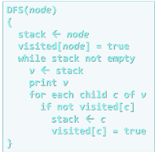
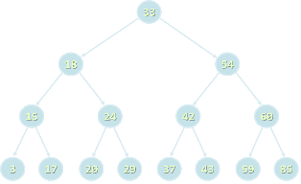

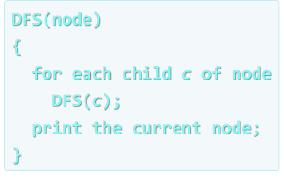

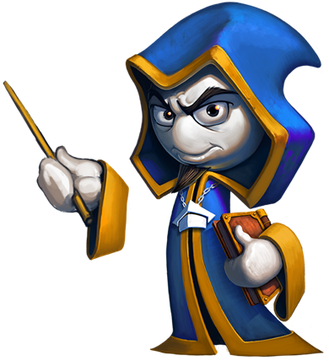
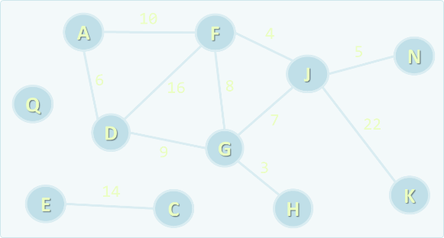
Algorithms
Course Overview
SoftUni Team
Technical Trainers
Software University
http://softuni.bg

Slide 2

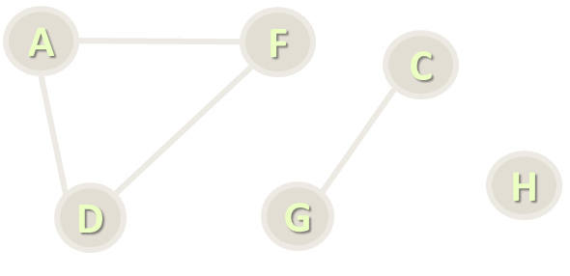
Table of Contents
Course Curriculum
Trainers Team
Examination
Learning Resources

Slide 3

Algorithms
Course Curriculum

Slide 4
Algorithms – Course Curriculum
Course Overview
Recursion, Sorting and Searching Algorithms
Combinatorial Algorithms
Greedy Algorithms
Dynamic Programming I
Dynamic Programming II

Slide 5
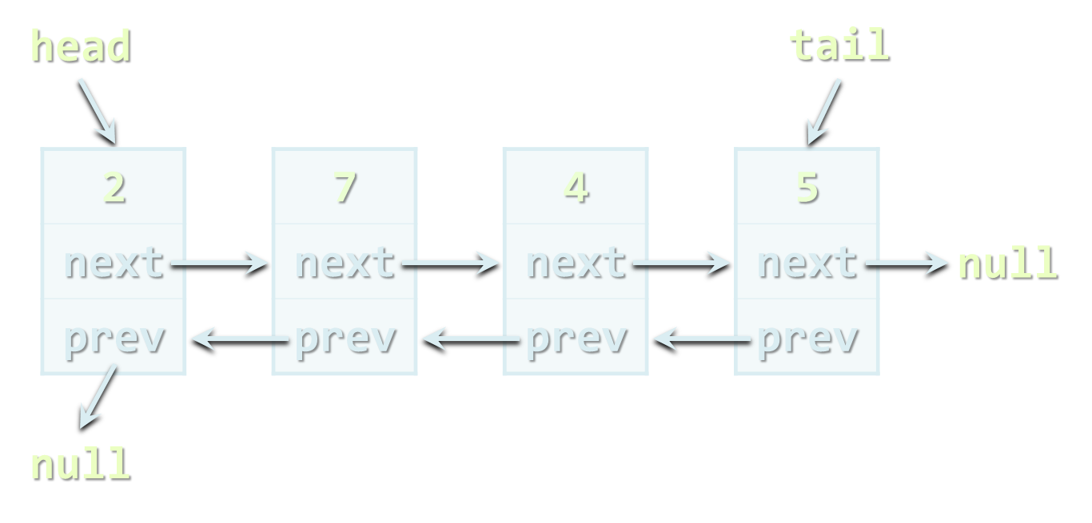
Algorithms – Course Program (2)
Graphs and Graph Algorithms
Advanced Graph Algorithms - Part I
Advanced Graph Algorithms - Part II
Problem Solving Methodology
Solving Practical Problems x 2
Exam Preparations x 2
Practical Exam

Slide 6
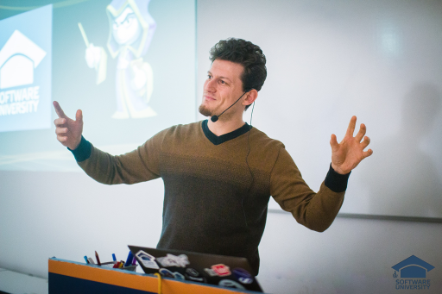
The Trainers Team

Slide 7
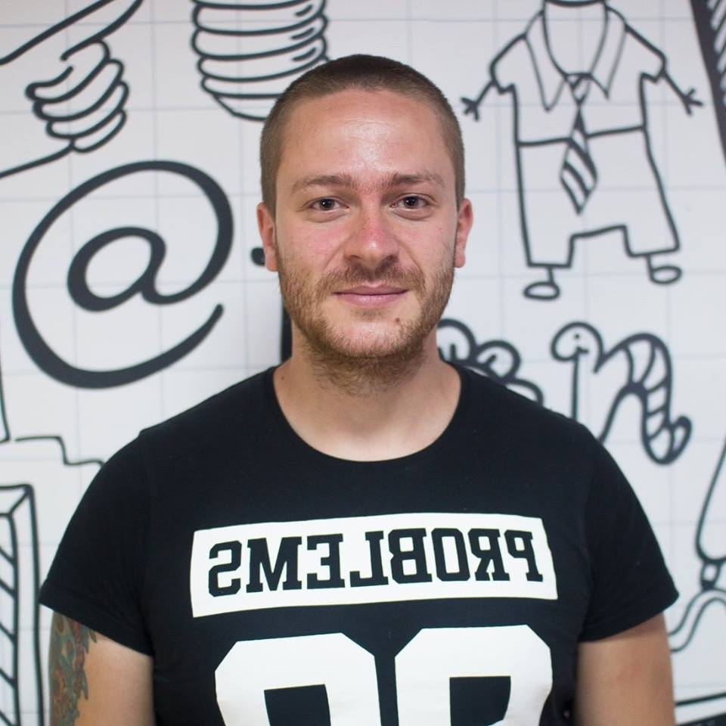
Trainers Team
Ivaylo Kenov
Various job titles at the same time:
Mathematical competitions champion
Full Stack Technical Trainer
Senior Software Developer
Solution Architect & Technical Lead
One-man army @ My Tested ASP.NET
Contacts:
https://github.com/ivaylokenov
https://facebook.com/ivaylo.kenov
https://linkedin.com/in/kenov

Slide 8

Training Duration – Algorithms
Lessons: ~ 25 hours (YouTube videos)
Exam preparation: ~8 hours
Homework: ~ 40-60 hours
Schedule: March – May 2019
Practical exam: 02 June 2019
Retake exam: 16 June 2019

Slide 9
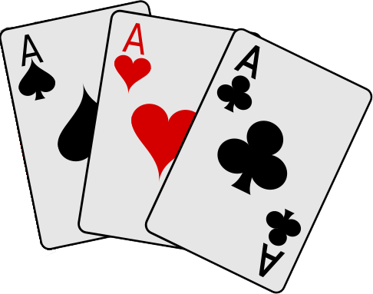
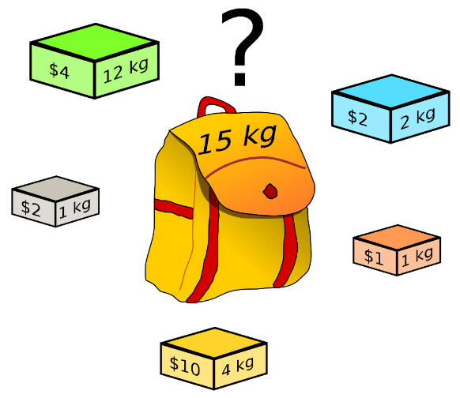

Problems We Will Be Solving
Combinations of Cards
Knapsack Problem
Subset Sum

Slide 10
Problems We Will Be Solving (2)
IDEs
17
20
conditionals
6
4
1
10
6
5
11
6
5
s
5
33
9
0
11
20
26
variables
loops
12
3
9
3
8
14
2
15
7
bits
Dijkstra's Shortest Path
Topological Sorting

Slide 11
Programming Languages
The recommended language for this course is C#
Exercises in class assume you will write in C# + Visual Studio
Labs and examples will also focus on C# and Visual Studio
Homework can be submitted in C# or Java
At the final exam attendees can use:
C# or Java

Slide 12
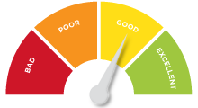

Scoring System for the "Algorithms"
Practical exam
90%
Labs/Homework (1 week deadline)
up to 10% bonus

Slide 13

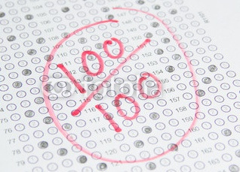
Algorithms – Practical Exam
4 problems for 6 hours
Graphs, dynamic programming, recursion, combinatorics, greedy, …
Automated judge system / real-time feedback

Slide 14









Resources
What We Need Additionally?

Slide 15



Algorithms Web Site, Forum and FB Group
Official web site:
Official discussion forum:
Official Facebook groups:
https://softuni.bg/trainings/2222/algorithms-march-2019-online
https://softuni.bg/forum/categories/32/strukturi-ot-danni-i-algoritmi
https://www.facebook.com/groups/AlgorithmsMarch2019/

Slide 16

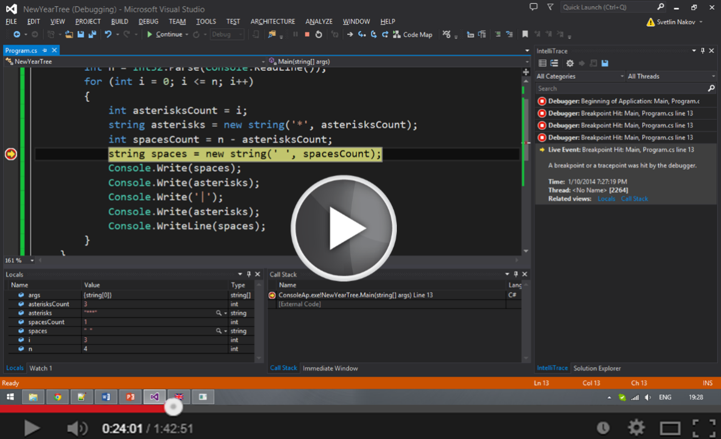

Algorithms Slides and Videos
All lecture slides, videos, homework assignments, labs and other resources are open content, available for free
Visit the course web site to access the course resources

Slide 17
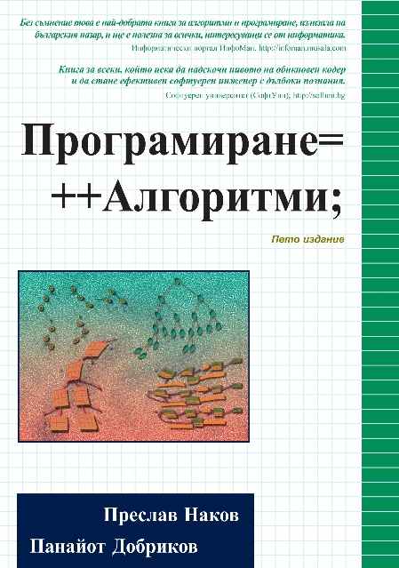
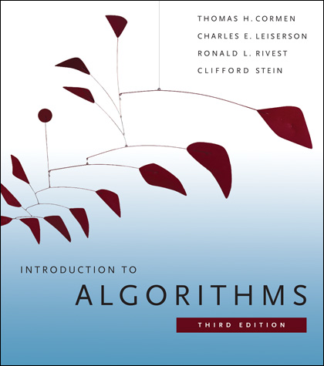
Algorithms – Additional Resources
Nakov P., Dobrikov P., "Programming = ++ Algorithms;", 5th Edition, ISBN: 954-8905-06-X, Faber Publishing (2015)
Download a free copy from: www.programirane.org
No English version (Bulgarian only)
Cormen T., Leiserson C., Rivest R., Stein C., "Introduction to Algorithms", 3rd Edition, ISBN 978-0262033848, MIT Press (2009)
Find the book in Internet: https://goo.gl/ElgQD3

Slide 18
Recommended Software
Visual Studio Community 2017
Or other C# development environment
SharpDevelop – lightweight IDE for C#
Xamarin Studio – powerful IDE for C# / .NET for Linux, Mac OS X, Windows and others
Eclipse / IntelliJ IDEA (for Java), Code::Blocks (for C++)

Slide 19

Contacts
t.stefanova@sotuni.bg

